Slide 1

OptiFlow Logistics ETL & Analytics Project
Transforming raw logistics data into actionable insights through end-to-end ETL and analytics

Slide 2
CHALLENGE
The Problem
Critical Issues
Rising Costs
Customer Impact
OptiFlow Logistics faces frequent shipment delays, high waiting times, inefficient asset utilization, and limited operational visibility—driving up costs and reducing customer satisfaction.
Operational inefficiencies increasing expenses
Delays reducing satisfaction levels
Planning Gaps
Limited visibility hindering demand forecasting

Slide 3
OBJECTIVES
Business Goals
01
02
Reduce Delays
Identify Bottlenecks
Minimize shipment delays and waiting times
Pinpoint key operational inefficiencies
03
04
Optimize Assets
Align Inventory
Improve utilization and allocation
Match inventory with demand forecasts
05
06
Quantify Impact
Enable Decisions
Measure financial cost of inefficiencies
Deliver interactive dashboards for stakeholders

Slide 4





Key Stakeholders
Operations Manager
Logistics Planner
Supply Chain Manager
Finance Team
Monitor delays, waiting times, and asset efficiency
Optimize routing, scheduling, and asset allocation
Improve inventory and demand alignment
Assess cost impact of operational delays
Executive Leadership
Track KPIs and overall operational performance

Slide 5


DATA
Dataset Overview
The dataset contains approximately 1,000 shipment-level records with comprehensive logistics attributes:
Timestamp, Asset ID, and Location data
Shipment Status, Delay Flags, and Waiting Time
Traffic Status and Logistics Delay Reasons
Asset Utilization metrics
Inventory Level and Demand Forecasts
Customer Transaction and Purchase Frequency
Environmental Factors (Temperature, Humidity)

Slide 6

ETL Architecture
Extract
Transform
Load
Visualize
The pipeline follows a one-directional data flow from source to insights, ensuring data quality and accessibility.
Extract
Transform
Load
Raw logistics data ingested from CSV files using Python Pandas
Data cleaning, feature engineering, and KPI calculations via SQL and Python
Transformed data written to MySQL with optimized views for analytics

Slide 7

CRITICAL FINDINGS
Key Insights from Analysis
56.6%
73.6%
$283K
Shipments Delayed
Overstocked
Cost Impact
Indicating systemic inefficiencies across operations
Inventory imbalance requiring better demand forecasting
Estimated financial impact from delayed shipments
79%
Asset Utilization
Stable utilization rate regardless of waiting time

Slide 8
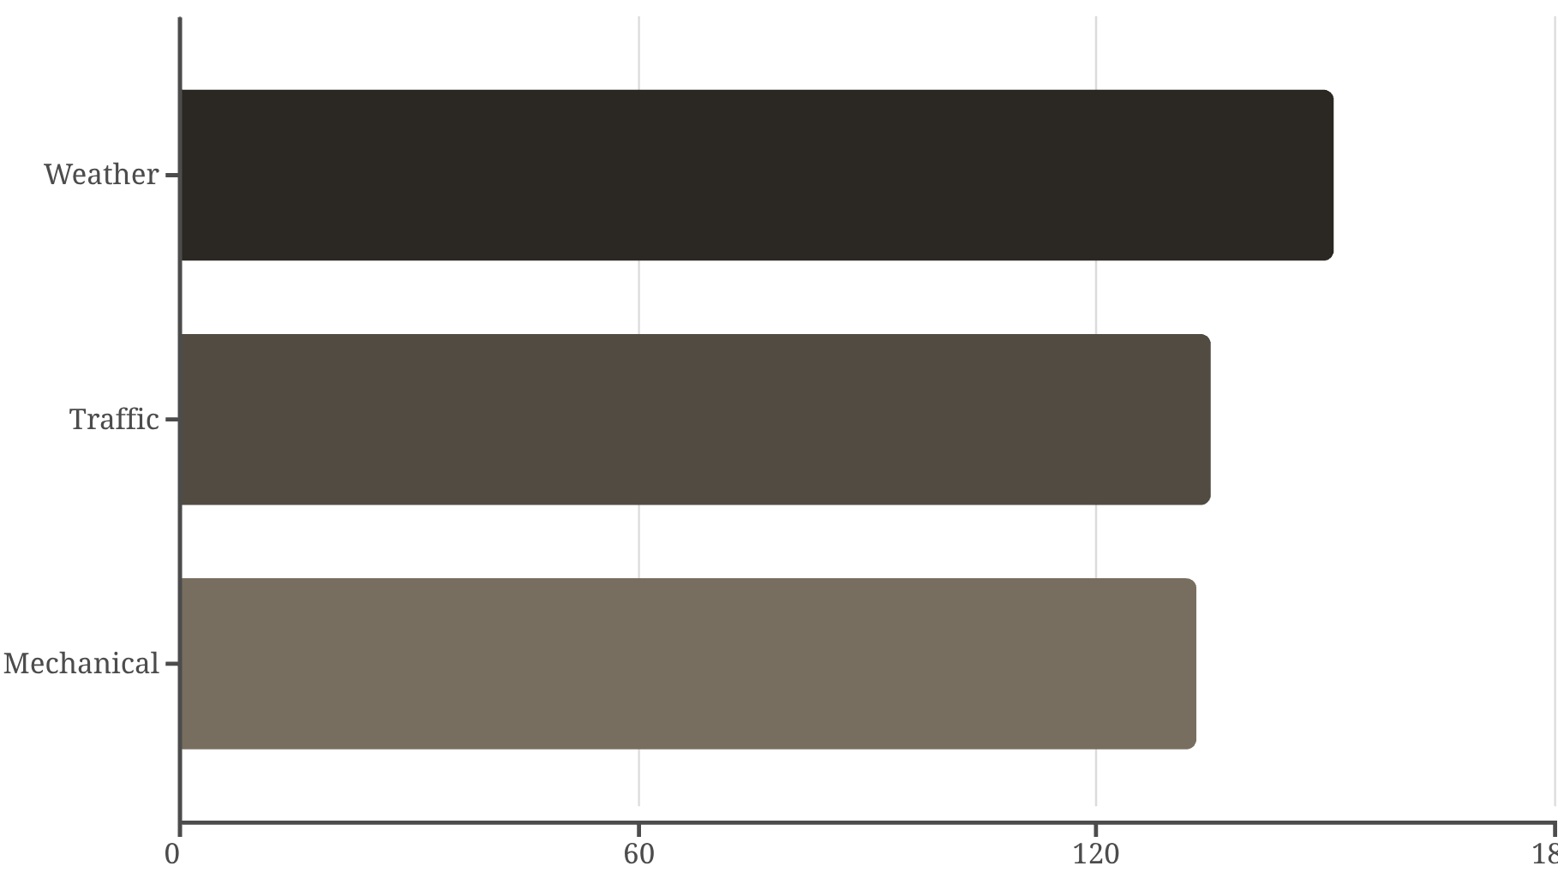

Delay Drivers & Patterns
Primary Delay Causes
Weather, traffic, and mechanical failures are the top three delay drivers. Delays peak during business hours (8 AM – 2 PM) with highest congestion on specific weekdays.
Key Finding: Higher delay rates observed under low-temperature conditions, while humidity remains consistently high.

Slide 9

DELIVERABLE
Power BI Dashboard Solution
Executive Overview
Shipment Analysis
KPIs, delay percentages, and cost impact at a glance
Delay reasons, peak hours, and congestion patterns
Operational Efficiency
Financial Impact
Waiting time metrics and weekly demand trends
Inventory status, temperature effects, and cost drivers
Features include interactive filters, slicers, page navigation, and KPI cards for comprehensive analysis.

Slide 10




RECOMMENDATIONS
Strategic Action Plan
Predictive Routing
Schedule Optimization
Use traffic and weather data for intelligent route planning
Avoid peak congestion hours to reduce delays
Preventive Maintenance
Inventory Alignment
Reduce mechanical failures through proactive servicing
Improve demand forecasting to reduce 73.6% overstocking
This end-to-end ETL and analytics solution demonstrates how integrating Python, SQL, and Power BI can uncover critical inefficiencies, quantify financial impact, and enable data-driven decisions that improve efficiency, reduce costs, and enhance customer satisfaction.

